Slide 1
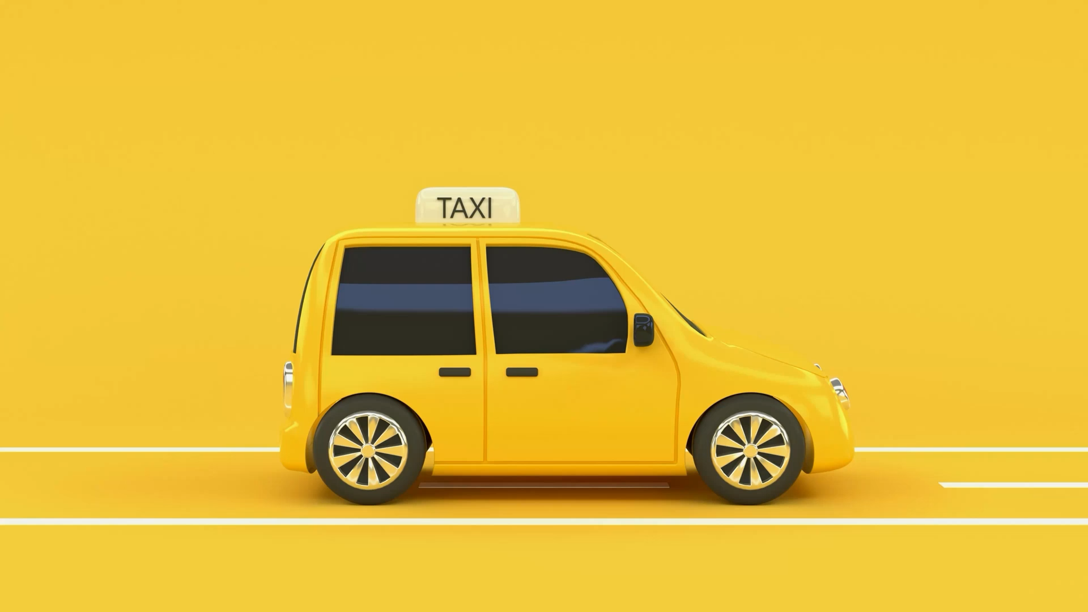
DriverHero: The Ultimate Voice Assistant for Taxi Drivers
Team10

Slide 2


Slide 3
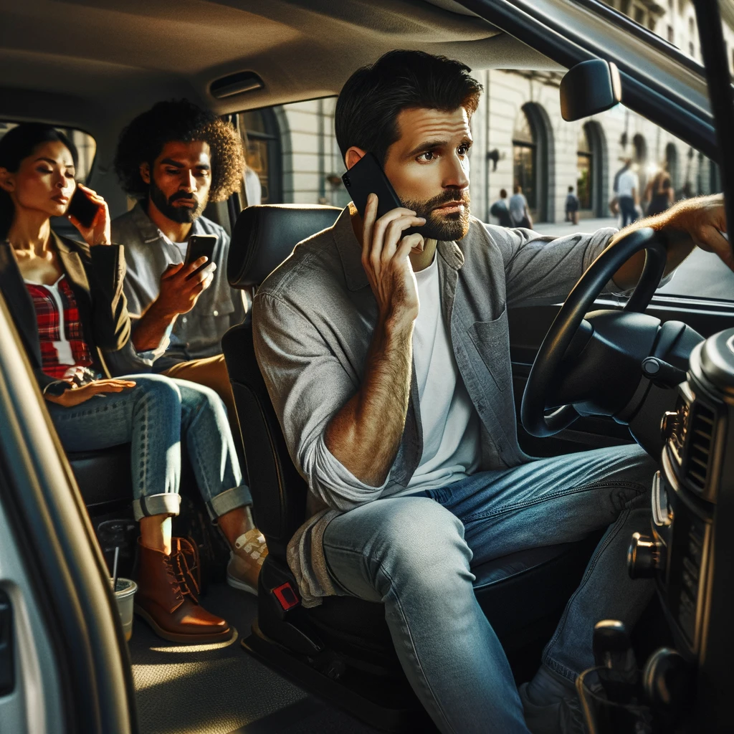

Slide 4
Components
Speech to text
Entity recognition
Text to speech
Moovex API integration
React frontend

